Slide 1

CSC 808 Combinational Logic Circuit Design Lecture Note 3 Ass. Prof O. N. akande
Lecturer:
Akande Noah O. (Ph. D.)
Notes:
CYB 482

Slide 2
Combinational Logic Circuit Design
A combinational logic circuit is a type of digital circuit where the output depends only on the present inputs and not on any past inputs or states.
They perform logical operations using basic logic gates and provide an immediate output for any given set of input values.

Slide 3
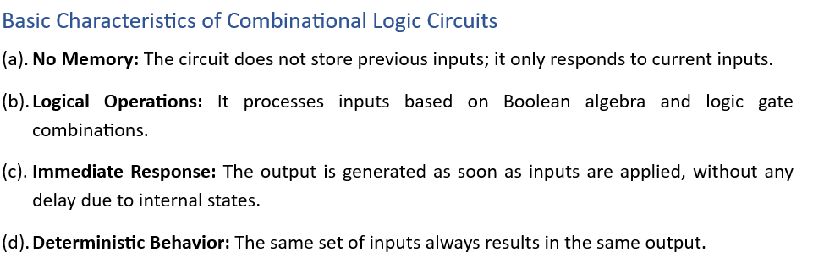
Combinational Logic Circuit Design

Slide 4
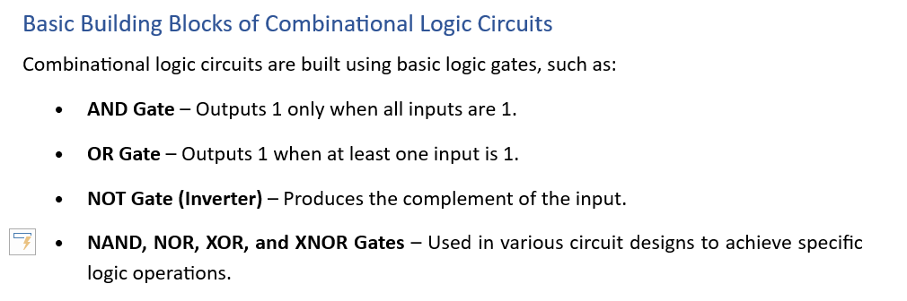
Combinational Logic Circuit Design

Slide 5
Combinational Logic Circuit Design
Combinational logic circuits can be constructed by using both Sum of Products (SOP) and Products of Sum (POS) terms.
It can be further simplified using the Boolean algebra theorems

Slide 6
Sum of Products (SOP)
SOP (or Minterms) logic expressions consist of two or more AND terms (products) that are Ored together.
In other words, a SOP logic expression is formed by selecting product terms for which the OUTPUT is “1” and Oring them together.
Example XYZ + X Y are in SOP form

Slide 7
Products of Sum (POS)
A POS (maxterms) consists of TWO or more OR terms that are ANDed together
In other words, a POS logic expression is formed by selecting product terms for which the OUTPUT is “0” and ANDing them together.
Example (X+Y+Z) (X+ Y + Z) are in POS form

Slide 8
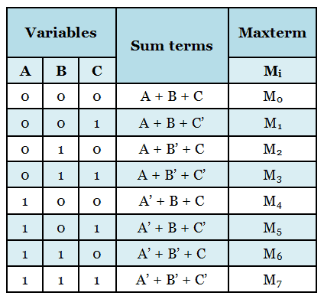
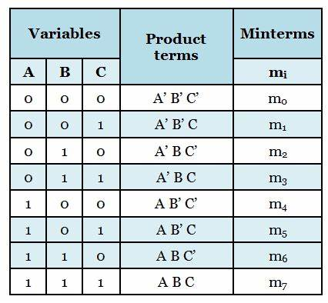
Combinational Logic Circuit Design

Slide 9
Exercise
A logic network has two inputs X and Y and an Output Z. The relationship between the input and output is given below:
When both X & Y are 0, Z is 1
When X is 0 and Y is 1, Z is 0
When X is 1 and Y is 0, Z is 1
When X is 1 and Y is 1, Z is 1
Design a combinational network to implement this problem.

Slide 10
X | Y | Z
0 | 0 | 1
0 | 1 | 0
1 | 0 | 1
1 | 1 | 1
POS = X + Y
SOP = X Y + X Y + X Y
= Y ( X + X ) + X Y
= Y + X Y
= Y (X+1) + X Y
= X Y + Y + X Y
= X (Y + Y) + Y
= X + Y

Slide 11
X | Y | Z
0 | 0 | 1
0 | 1 | 0
1 | 0 | 1
1 | 1 | 1
Using perfect induction to prove that the answer is correct:
= X + Y
X | Y | Y | Z
0 | 0 | 1 | 1
0 | 1 | 0 | 0
1 | 0 | 1 | 1
1 | 1 | 0 | 1

Slide 12
Exercise
A logic circuit with three inputs X, Y, Z is to be designed. Assume that the designed relationship between the input and the output is shown in the table below:

Slide 13
Exercise
X | Y | Z | W
0 | 0 | 0 | 1
0 | 0 | 1 | 0
0 | 1 | 0 | 1
0 | 1 | 1 | 0
1 | 0 | 0 | 1
1 | 0 | 1 | 0
1 | 1 | 0 | 1
1 | 1 | 1 | 0
SOP = Z
POS =

Slide 14
Exercise
Use law of Boolean Algebra to simplify this expression:
(X + Y + Z) (X + Y + Z) (X + Y + Z) (X + Y + Z)

Slide 15
Exercise
A logic circuit has three inputs X, Y, Z and an output W. The output W gives a HIGH signal whenever the combinations of the inputs are all zeros or even. Whenever the combinations of the inputs are odd, a LOW output will be produced.
Draw a truth table to represent this scenario
Simplify the expression using either POS or SOP rules
Draw the logic circuit of the simplified expression.

Slide 16
Exercise
An analog-digital converter was designed to monitor the dc voltage of a 12v storage battery on an orbiting spaceship. The converter’s INPUT is a four bit binary number A B C D corresponding to the battery voltage in steps of 1v. The converter’s binary outputs are fed to a logic circuit that is to produce a HIGH output whenever the binary output is greater than 0110₂ = 6₁₀ that is when the battery voltage is greater than 6v
Draw a truth table to represent this scenario
From the truth table, obtain a simplified SOP expression using Boolean algebra techniques.
Draw the logic circuit of the simplified SOP expression.
Design a logic circuit to implement the expression using NAND gates only.

Slide 17
Exercise
A logic circuit has four inputs D, C ,B, A that is encoded in 8421 natural binary form. The inputs in the range 0000=0 to 1011=11 represents the months of the year from JANUARY (0) to DECEMBER (11). Inputs in the range 1100 to 1111 (i.e. 12-15) cannot occur. The output of the circuit is a logical one (1) if the month represented by the input has 31 days, otherwise the input is FALSE.
Draw a truth table to represent this scenario
From the truth table, obtain a simplified SOP expression using Boolean algebra techniques.
Draw the logic circuit of the simplified SOP expression.
Design a logic circuit to implement the expression using NAND gates only.

Slide 18
CSC 808 Simplifying Boolean functions using Karnaugh-map Lecture Note 3 Ass. Prof O. N. akande
Lecturer:
Akande Noah O. (Ph. D.)
Notes:
CYB 482

Slide 19
Karnaugh Map (KMap)
Karnaugh-Map (K-Map) is a graphical and a more effective approach for representing and simplifying Boolean expression.
2^{n} input truth table will have 2^{n} input K- Map.

Slide 20
Simplifying Boolean Functions using Karnaugh - Map
Two - Variable K-Map
One - Variable K-Map
A
0
1
0
1
A B | A B
A B | A B
B
A | A
0
1
AB
00
01
11
10
C
A B C | A B C | A B C | A B C
A B C | A B C | A B C | A B C
0
Three – Variable
K-Map
1

Slide 21
Four - Variable K-Map
AB
00
01
11
10
CD
A B C D | A B C D | A B C D | A B C D
A B C D | A B C D | A B C D | A B C D
A B C D | A B C D | A B C D | A B C D
A B C D | A B C D | A B C D | A B C D
00
01
11
10

Slide 22
How to use a K - Map
Determine the number of variable involved
Determine the form of Boolean expression (SOP or POS) that will be transferred from the truth table to the map.
Enter 1 entry for SOP and 0 for POS.
Group or loop the 1’s or 0’s on the map
Read the loop of 0’s or 1’s on the map and Simplify vertically and horizontally

Slide 23
Example 1
A | B | C | Z
0 | 0 | 0 | 1
0 | 0 | 1 | 0
0 | 1 | 0 | 0
0 | 1 | 1 | 1
1 | 0 | 0 | 0
1 | 0 | 1 | 0
1 | 1 | 0 | 1
1 | 1 | 1 | 0
USING SOP
AB
C
00
01
11
10
0
1 |  | 1
 | 1
1
Z= A B C + A B C + A B C

Slide 24
Example 2
AB
00
01
11
10
C D
1 | 1 | 1 | 1
1 |  |  | 1
1 |  |  | 1
1 | 1 | 1 | 1
00
01
11
10
Z = B + D

Slide 25
Example 3
AB
00
01
11
10
C D
 | 0 | 0
 | 0 | 0
00
01
11
10
Z = B D

Slide 26
Example 4
An analog to digital converter is monitoring the CD voltage of a 12v storage battery on an orbital spaceship. The converter’s input is a four-bit binary number A, B, C, D corresponding to the battery voltage in steps of 1v. The converter’s binary outputs are fed to a logic circuit that is to produce a HIGH output as long as the binary value is greater than 0110₂ = 6₁₀ .
Use K-Map to obtain a simplified SOP expression for the output.

Slide 27
A | B | C | D | Z
0 | 0 | 0 | 0 | 0
0 | 0 | 0 | 1 | 0
0 | 0 | 1 | 0 | 0
0 | 0 | 1 | 1 | 0
0 | 1 | 0 | 0 | 0
0 | 1 | 0 | 1 | 0
0 | 1 | 1 | 0 | 0
0 | 1 | 1 | 1 | 1
1 | 0 | 0 | 0 | 1
1 | 0 | 0 | 1 | 1
1 | 0 | 1 | 0 | 1
1 | 0 | 1 | 1 | 1
1 | 1 | 0 | 0 | 1
1 | 1 | 0 | 1 | 1
1 | 1 | 1 | 0 | 1
1 | 1 | 1 | 1 | 1
AB
00
01
11
10
CD
 |  | 1 | 1
 |  | 1 | 1
 | 1 | 1 | 1
 |  | 1 | 1
00
01
11
10
Z = A + BCD

Slide 28
How to use a K - Map
Determine the number of variable involved
Determine the form of Boolean expression (SOP or POS) that will be transferred from the truth table to the map.
Enter 1 entry for SOP and 0 for POS.
Group or loop the 1’s or 0’s on the map
Read the loop of 0’s or 1’s on the map and express it as SOP or POS

